Slide 1
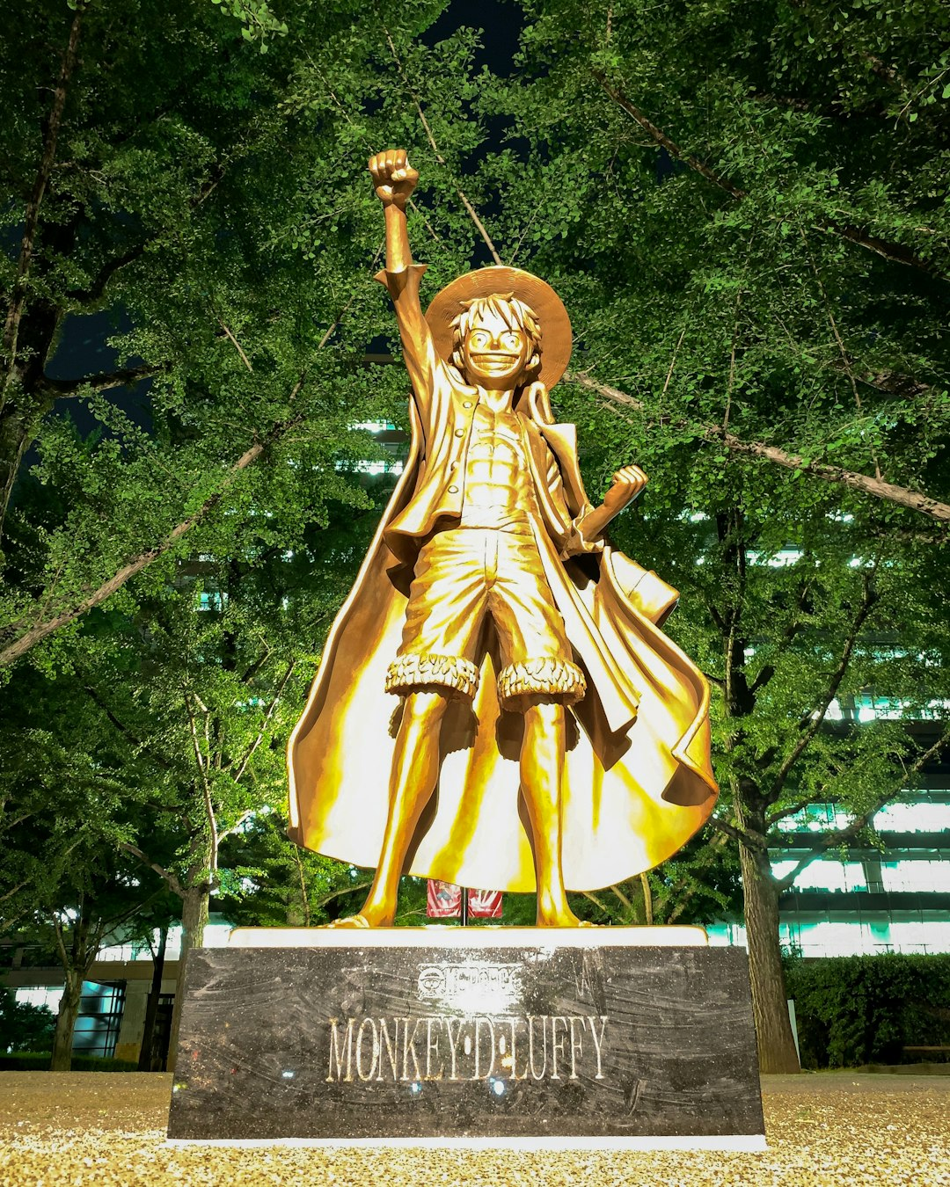
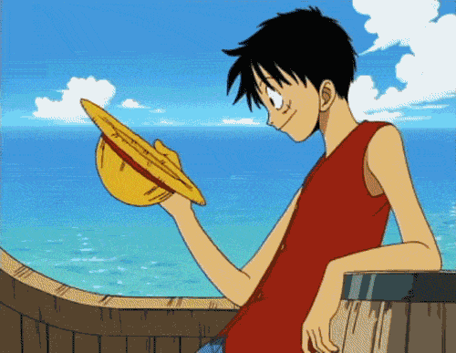
ANIME & IT’S HISTORY
NAME: Srujan Wankhade DATE: JANUARY - 2025

Slide 2
ANIME & IT’S HISTORY
NAME: Srujan Wankhade DATE: JANUARY - 2025

Slide 3
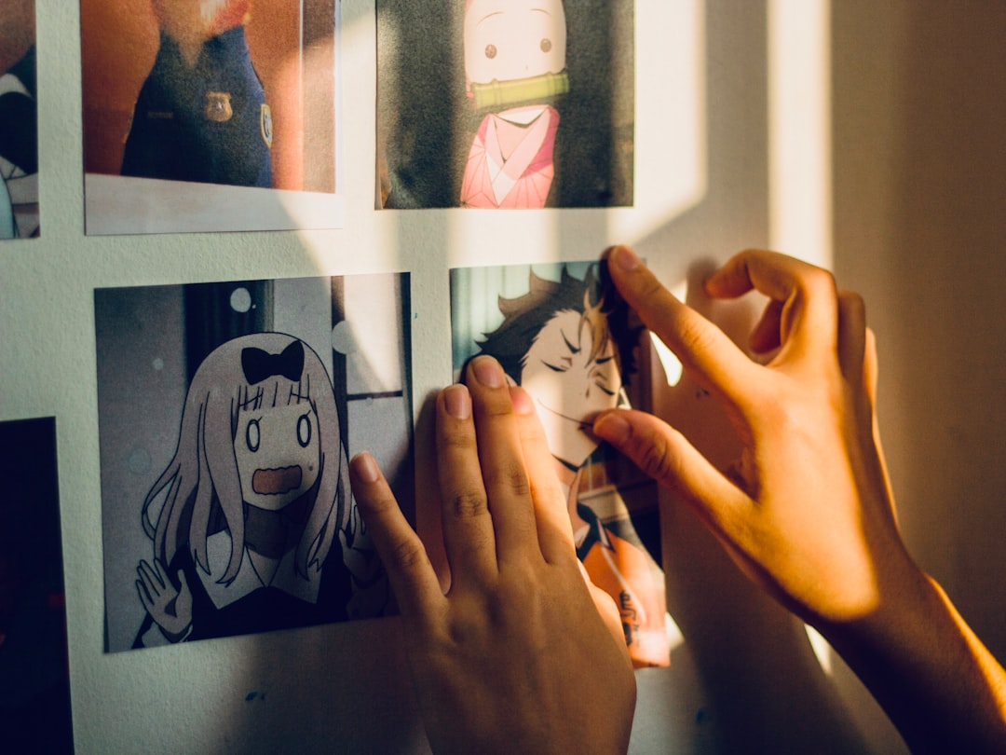

WHAT IS ANIME?
1.A unique style of animation from Japan.
2.Features vibrant characters and imaginative storytelling.
3.Caters to diverse genres and age groups.
4.Anime often features complex narratives and deep themes, exploring topics such as identity and morality

Slide 4
WHAT IS ANIME?
1.A unique style of animation from Japan.
2.Features vibrant characters and imaginative storytelling.
3.Caters to diverse genres and age groups.
4.Anime often features complex narratives and deep themes, exploring topics such as identity and morality

Slide 5
WHAT IS ANIME?
1. A unique style of animation from Japan.
2. Features vibrant characters and imaginative storytelling.
3. Caters to diverse genres and age groups.
4. Anime often features complex narratives and deep themes, exploring topics such as identity and morality

Slide 6



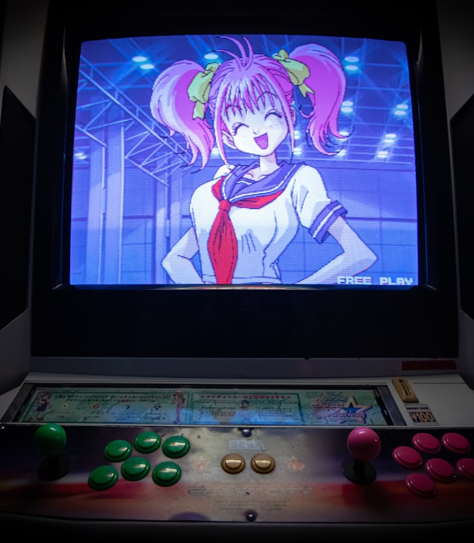

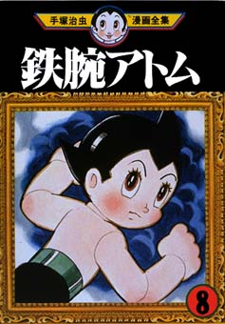
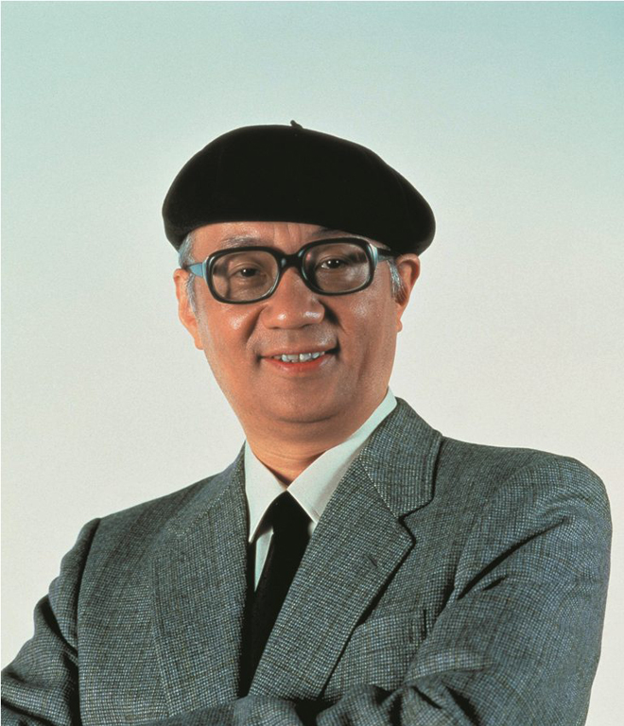
EARLY ANIME BEGINNINGS
The Rise of Genres (1970s)
• Emergence of Mecha, Shonen, and Shojo genres.
• Experimentation with storytelling and character development.
The Father Of Anime
• Osamu Tezuka revolutionized the industry.
• Created Astro Boy, Japan's first animated TV series.
• Roots in ukiyo-e and kamishibai.
• First anime film: Namakura Gatana (1917).

Slide 7
EARLY ANIME BEGINNINGS
The Rise of Genres (1970s)
• Emergence of Mecha, Shonen, and Shojo genres.
• Experimentation with storytelling and character development.
The Father Of Anime
• Osamu Tezuka revolutionized the industry.
• Created Astro Boy, Japan's first animated TV series.
• Roots in ukiyo-e and kamishibai.
• First anime film: Namakura Gatana (1917).

Slide 8
EARLY ANIME BEGINNINGS
The Rise of Genres (1970s)
• Emergence of Mecha, Shonen, and Shojo genres.
• Experimentation with storytelling and character development.
The Father Of Anime
• Osamu Tezuka revolutionized the industry.
• Created Astro Boy, Japan's first animated TV series.
• Roots in ukiyo-e and kamishibai.
• First anime film: Namakura Gatana (1917).

Slide 9
EARLY ANIME BEGINNINGS
The Rise of Genres (1970s)
• Emergence of Mecha, Shonen, and Shojo genres.
• Experimentation with storytelling and character development.
The Father Of Anime
• Osamu Tezuka revolutionized the industry.
• Created Astro Boy, Japan's first animated TV series.
• Roots in ukiyo-e and kamishibai.
• First anime film: Namakura Gatana (1917).

Slide 10
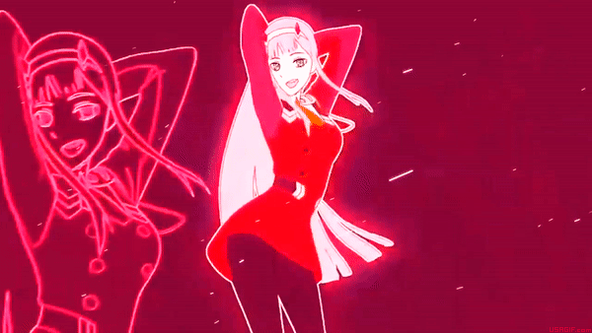
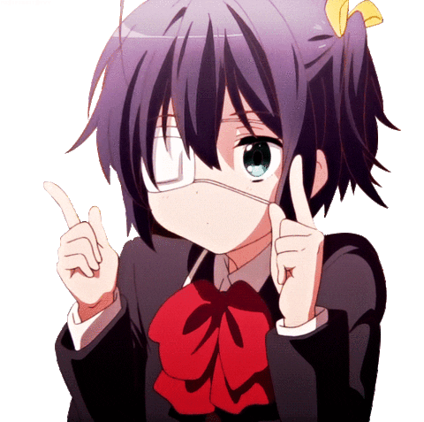
GLOBAL EXPANSION IMPACT (1990s)
The Golden Era of Anime (1980s)
• Founding of Studio Ghibli with classics like My Neighbor Totoro.
• Iconic shows like Dragon Ball and Akira gained global recognition.
• International fame for Sailor Moon, Pokemon, and Evangelion.
• Merchandise and dubbing increased popularity worldwide.
Global Impact
Cultural Exchange: Anime introduces global audiences to Japanese culture, traditions, and social issues, fostering greater understanding and appreciation.
Influence on Western Media: Anime has inspired Western creators in film, television, and video games, integrating its storytelling techniques and art styles into various entertainment forms.
Economic Impact: The global popularity of anime has boosted the entertainment industry, creating economic opportunities through merchandise sales, streaming services, and international licensing.
Diversity in Storytelling: Anime explores complex themes such as identity and mental health, contributing to more inclusive narratives and encouraging discussions on social issues among viewers.

Slide 11
GLOBAL EXPANSION IMPACT (1990s)
The Golden Era of Anime (1980s)
• Founding of Studio Ghibli with classics like My Neighbor Totoro.
• Iconic shows like Dragon Ball and Akira gained global recognition.
• International fame for Sailor Moon, Pokemon, and Evangelion.
• Merchandise and dubbing increased popularity worldwide.
Global Impact
Cultural Exchange: Anime introduces global audiences to Japanese culture, traditions, and social issues, fostering greater understanding and appreciation.
Influence on Western Media: Anime has inspired Western creators in film, television, and video games, integrating its storytelling techniques and art styles into various entertainment forms.
Economic Impact: The global popularity of anime has boosted the entertainment industry, creating economic opportunities through merchandise sales, streaming services, and international licensing.
Diversity in Storytelling: Anime explores complex themes such as identity and mental health, contributing to more inclusive narratives and encouraging discussions on social issues among viewers.

Slide 12
GLOBAL EXPANSION IMPACT (1990s)
The Golden Era of Anime (1980s)
Global Impact
Cultural Exchange: Anime introduces global audiences to Japanese culture, traditions, and social issues, fostering greater understanding and appreciation.
Influence on Western Media: Anime has inspired Western creators in film, television, and video games, integrating its storytelling techniques and art styles into various entertainment forms.
Economic Impact: The global popularity of anime has boosted the entertainment industry, creating economic opportunities through merchandise sales, streaming services, and international licensing.
Diversity in Storytelling: Anime explores complex themes such as identity and mental health, contributing to more inclusive narratives and encouraging discussions on social issues among viewers.
• Founding of Studio Ghibli with classics like My Neighbor Totoro.
• Iconic shows like Dragon Ball and Akira gained global recognition.
• International fame for Sailor Moon, Pokemon, and Evangelion.
• Merchandise and dubbing increased popularity worldwide.

Slide 13
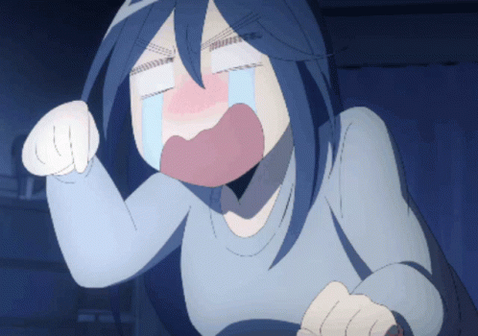


CHALLENGES IN ANIME
Influence of Studios
Artistic Style of Anime
• Industry overwork: Long hours and low pay.
• Misconceptions: Anime often seen as 'cartoons for kids.’
• Piracy issues threaten sustainability.
• Exaggerated expressions and vibrant color palettes.
• Focus on fluid motion and cinematic storytelling.
• Which many times lead to unrealistic expectations from the Fandom.
• Which then lead to the Bad reputation of the industry.
• Studio Ghibli: Emotional storytelling (Spirited Away).
• Toei Animation: Classics like One Piece and Dragon Ball.
• MAPPA: Modern hits like Jujutsu Kaisen.

Slide 14
CHALLENGES IN ANIME
Influence of Studios
Artistic Style of Anime
• Industry overwork: Long hours and low pay.
• Misconceptions: Anime often seen as 'cartoons for kids.’
• Piracy issues threaten sustainability.
• Exaggerated expressions and vibrant color palettes.
• Focus on fluid motion and cinematic storytelling.
• Which many times lead to unrealistic expectations from the Fandom.
• Which then lead to the Bad reputation of the industry.
• Studio Ghibli: Emotional storytelling (Spirited Away).
• Toei Animation: Classics like One Piece and Dragon Ball.
• MAPPA: Modern hits like Jujutsu Kaisen.

Slide 15
CHALLENGES IN ANIME
Influence of Studios
Artistic Style of Anime
• Industry overwork: Long hours and low pay.
• Misconceptions: Anime often seen as 'cartoons for kids.’
• Piracy issues threaten sustainability.
• Exaggerated expressions and vibrant color palettes.
• Focus on fluid motion and cinematic storytelling.
• Which many times lead to unrealistic expectations from the Fandom.
• Which then lead to the Bad reputation of the industry.
• Studio Ghibli: Emotional storytelling (Spirited Away).
• Toei Animation: Classics like One Piece and Dragon Ball.
• MAPPA: Modern hits like Jujutsu Kaisen.

Slide 16
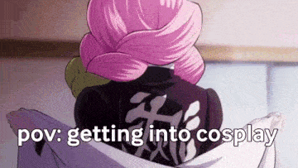


FUTURE OF ANIME
Expanding themes to reflect global issues.
Modern Era and Streaming (2000s–Today):-
Innovations like CGI and VR are shaping production.
Growing fandom with increasing accessibility.
• Streaming platforms like Crunchyroll and Netflix expanded access.
• Series like Attack on Titan and Demon Slayer broke records..
• As the popularity of anime increase more and more its is produced.

Slide 17
FUTURE OF ANIME
Expanding themes to reflect global issues.
Modern Era and Streaming (2000s–Today):-
Innovations like CGI and VR are shaping production.
Growing fandom with increasing accessibility.
• Streaming platforms like Crunchyroll and Netflix expanded access.
• Series like Attack on Titan and Demon Slayer broke records..
• As the popularity of anime increase more and more its is produced.

Slide 18
FUTURE OF ANIME
Expanding themes to reflect global issues.
Modern Era and Streaming (2000s–Today):-
Innovations like CGI and VR are shaping production.
Growing fandom with increasing accessibility.
• Streaming platforms like Crunchyroll and Netflix expanded access.
• Series like Attack on Titan and Demon Slayer broke records..
• As the popularity of anime increase more and more its is produced.

Slide 19

CONCLUSION
• Anime is an art form reflecting creativity and culture.
• Its journey showcases local beginnings to global recognition.
• What does anime mean to you?

Slide 20
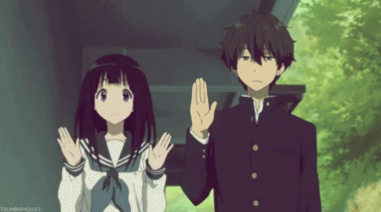
CONCLUSION
• Anime is an art form reflecting creativity and culture.
• Its journey showcases local beginnings to global recognition.
• What does anime mean to you?

Slide 21
CONCLUSION
• Anime is an art form reflecting creativity and culture.
• Its journey showcases local beginnings to global recognition.
• What does anime mean to you?

Slide 22
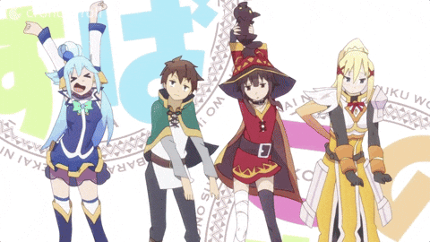

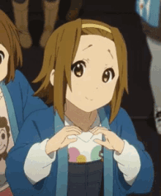
This Photo by Unknown Author is licensed under CC BY-NC

